Slide 1
Bi -Weekly ELA Activities
Weeks of April 6th to April 17th
Topic of Focus: Children’s Rights

Slide 2
How this works
These are your ELA activities for the next 2 weeks. Work at times and at a pace that works best for you and your family. The daily assignments are a good way to keep a routine, but it is only a suggested time frame.
Step 1 - Make a Google Slide. Name it - your name: Week 1and2 ELA on the first slide
(Example - Andrew: Week 1 and 2 ELA)
Step 2 - Share it with me so I can follow along and support you.
Step 3 - Title each slide using the title I gave you for each daily activity.
If you have a difficulty or questions with any of the activities please email me explaining what the issue or question is. I also suggest that you can work online with classmates to support and help each other.
Good Luck and remember, we are all figuring this out together.

Slide 3
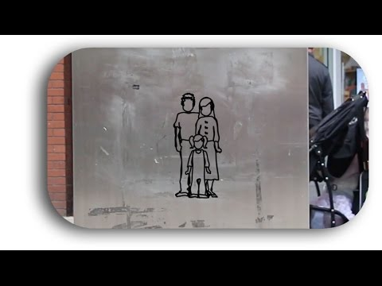
Monday
Reading Activity:
-Read the summary of Children’s Rights. Click here
~THEN~
Watch this video:
Writing Activity:
Title this slide: Summary Of Rights
Write a response to the summary of rights and video in complete sentences. Include:
1 question you still have about rights
2 things that you learned.
3 countries where you think rights are not protected.

Slide 4
Tuesday
Reading Activity:
Newsela Article: “Some say greedy bosses will try to get around new child-labor laws in India”
Search it up on Newsela.
Writing Activity
Title this slide: My top 3 Rights
My top 3 most important rights. Click Here for instructions

Slide 5
Wednesday
Reading Activity
Read: Mike’s Case Study
Writing Activity:
Title This Slide: Mike’s Case Study
Write a paragraph explaining 3 rights Mike does not have protected and explain how you know this.
Infer: Means to use the evidence you have read to make a conclusion, even if it is not stated directly in what you read.

Slide 6
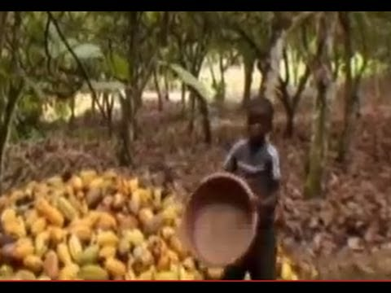
Thursday
Video Activity:
Watch this video
Writing Activity:
Title this slide: Dark Side of Chocolate
Write a paragraph response to this video. In detail explain things you learned, What shocked you, how it made you feel, did it change how you feel about chocolate?

Slide 7
Friday
Reading Activity
Read the article: Human Rights: Questions and Answers.
Click Here
Writing Activity:
Title Today’s slide: Kahoot
Create a Kahoot about this article. Make sure your questions can be answered after reading this article. Write 8 to 10 questions and have at least 3 reasonable answers for each question. Take a screenshot when you are done and put it in today’s slide.
Refresher: How to take screenshot: click here

Slide 8
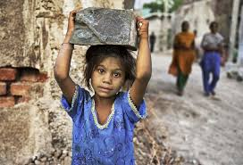
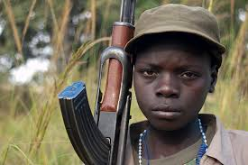
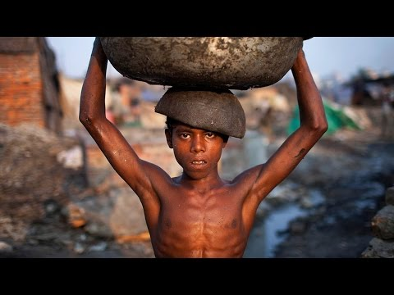
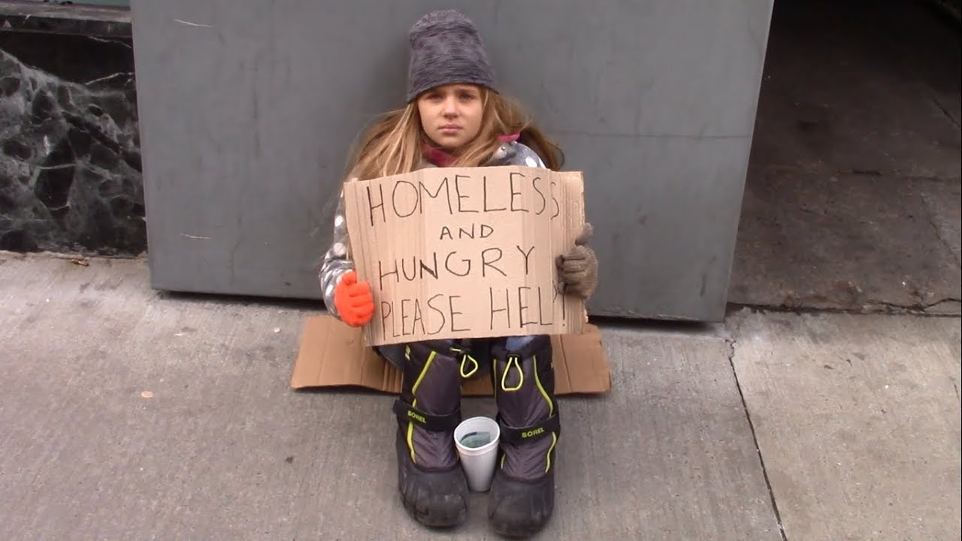
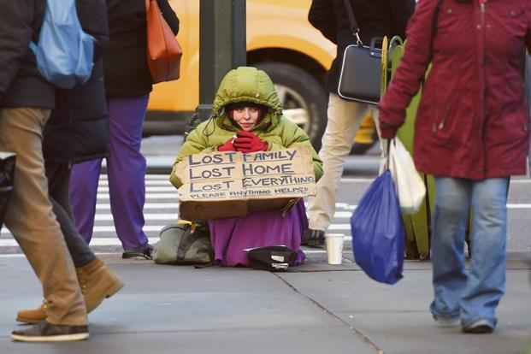
Monday
Reading Activity
Newsela Article: Despite efforts, child labor abuse hasn't stopped on cocoa farms
Search Newsela for it.
Watch this
video
Writing Activity:
Title This Slide: Picture Prompt
Choose on one of these pics. Copy and paste it on today’s slide. Write a story that includes this scene.

Slide 9
Tuesday
Reading Activity
Read the picture book:
We are All Born Free
Click Here
Writing Activity:
Title today’s slide: We are All Born Free.
Use this slide to make your own page in this book. Write a few sentences explaining the right you want to promote. (refer to the book for examples). You can either draw your picture and write your sentences on that, then take a picture of ir and paste it on today’s slide.
OR
Find a picture from google images that represents your right and paste it on today’s slide along with your writing piece.

Slide 10
Wednesday
Reading Activity:
Edwin Article: What are Human Rights Issues?
Search it in Edwin :)
***make sure to click on the countries in the article and read the information***
Writing Activity:
Name today’s Slide: What Are the Issues?
On today’s slide list 3 things you learned from today’s reading. Use complete sentences.

Slide 11
Thursday
Reading Activity:
Edwin Article: What are Human Rights?
The article is in the Google Reading Classroom
Writing Activity:
Name Today’s Slide: Persuasive Paragraph
Review Persuasive Paragraphs: Click Here
Read the case study (click here) and now write a persuasive paragraph to persuade someone that Moussa does not have at least 3 of his rights protected. Write the paragraph on today’s slide. Today you can just brainstorm your ideas and arguments.

Slide 12
Friday
Writing Activity:
Continue the Persuasive Paragraph. Write first draft.
For an example of how to develop the paragraph. Click Here.
Writing Activity:
When you are done your first draft it is time to reread, edit and revise. Have a parent or sibling read over it with you if possible.
When you are done please make sure you shared the ELA Weekly Google slide with me.
Rubric used for assessing (click here)

