Slide 1
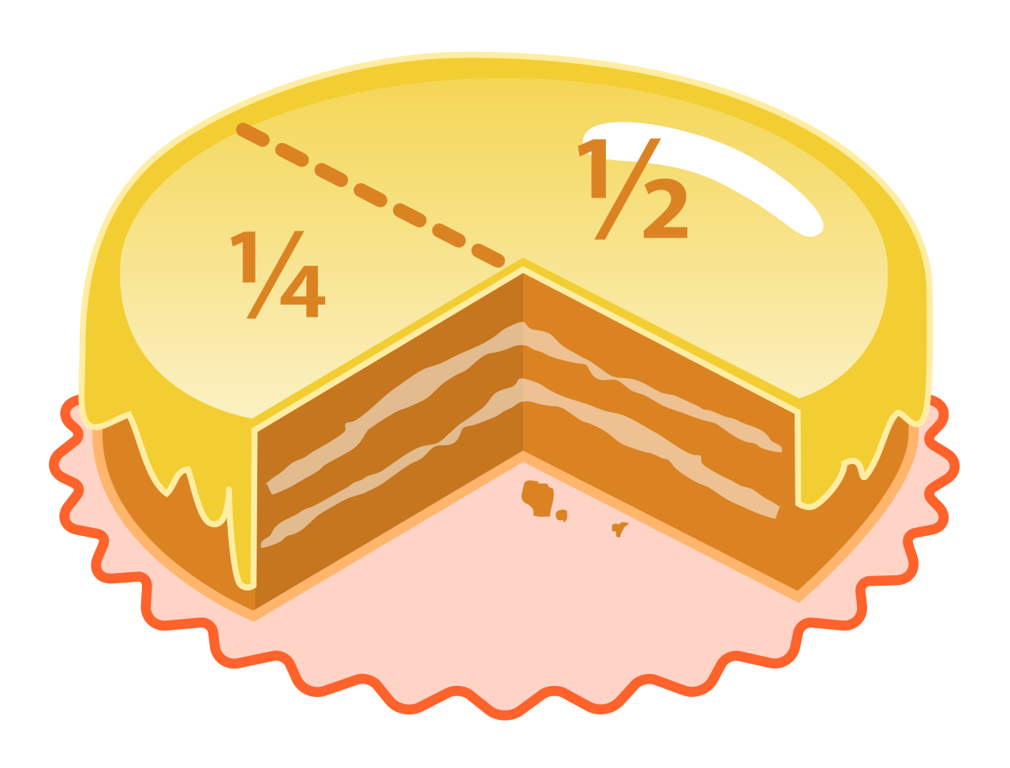
Fractions Unit
Grade 6 - SHJH - Week 1
Learning Goals: I can …
Show that an improper fraction represents a number larger than one
Express improper numbers as mixed fractions
Express mixed fractions as mixed numbers

Slide 2
Engage - Wednesday
Instructions:
Watch the Math Antics video to refresh your memory of what a fraction is.
Click on the picture to open a new slide. Review the slides to see examples of fractions we see around us.

Slide 3
Explore
Type answer here
Put answers here. Use “insert, shapes” to help you.
Type answer here
Type answer here
Type answer here
Type answer here
Create your own problem here. Use symbols or emojis to help.
Type answer here

Slide 4
Explain - Wednesday
What’s one thing you learned/remembered about
fractions?
Where’s a place that you’ve seen fractions used around your home?
What’s one question you still have about fractions?

Slide 5
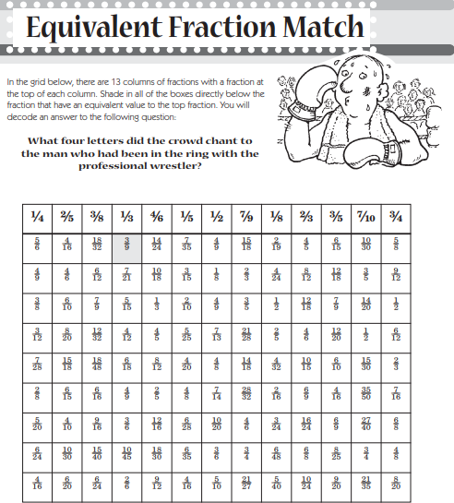
Extend - Wednesday
If you’ve finished early or would like more
practice, check out some of these extension
activites:
Online Fraction games
Fraction fling
Fraction Matcher
Copy this photo and use your google canvas to solve the puzzle!

Slide 6
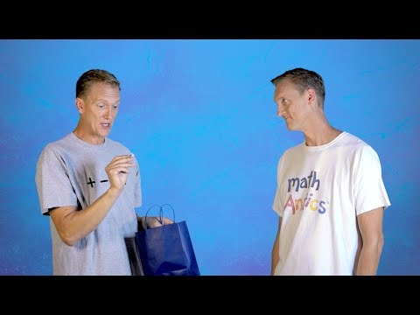
Engage - Thursday
Instructions:
Watch the Math Antics video to learn more about mixed numbers and improper fractions.
Click on the Edwin logo to take you to an Edwin video that will teach you more about mixed numbers and improper fractions.

Slide 7
Explore - Thursday
Instructions:
Click on the math textbook to take you to an online copy of the unit we’re currently working on, Fractions, Ratios & Percents
Practice:
Read through pages 160-163 to make sure you understand how mixed numbers and improper fractions are related.
On your own paper, do questions #1, 2, & 4 on page 164.

Slide 8
Explain - Thursday
What’s one thing you learned/remembered about
mixed numbers and improper fractions?
Where’s a place that you’ve seen improper fractions or mixed numbers in the world?
What’s one question you still have about improper fractions or mixed numbers?

Slide 9
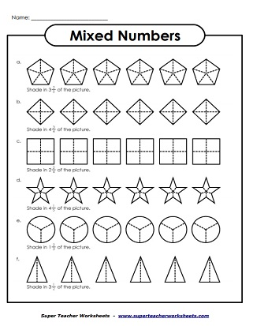
Extend - Thursday
If you’ve finished early or would like more
practice, check out some of these extension
activites:
Online games:
Icecream Shop

Slide 10
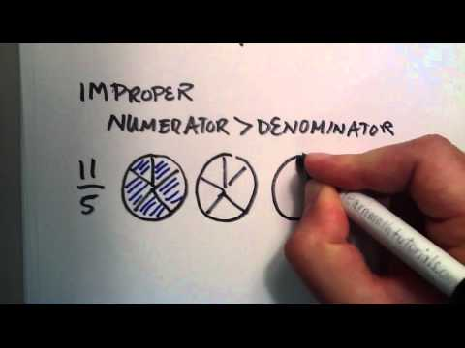
Engage - Friday
Instructions:
Watch the video to learn more about the difference between fractions, mixed numbers and improper fractions.
Click on the Edwin logo to take you to an Edwin activity that allows you to model proper and improper fractions using pattern blocks.

Slide 11
Explore - Friday
Instructions:
Click on the math textbook to take you to an online copy of the unit we’re currently working on, Fractions, Ratios & Percents
Practice:
If needed, review pages 160-163 to make sure you understand how mixed numbers and improper fractions are related.
On your own paper, do questions #5 or 6 on page 165.

Slide 12
Explain - Friday
What’s one thing you learned/remembered about
mixed numbers and improper fractions?
Where’s a place that you’ve seen improper fractions or mixed numbers in the world?
What’s one question you still have about improper fractions or mixed numbers?

Slide 13
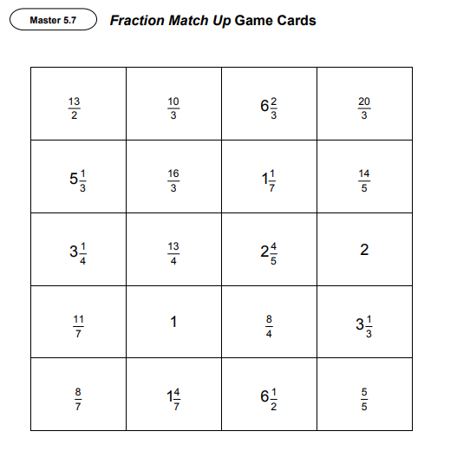
Extend - Friday
If you’ve finished early or would like more
practice, check out some of these extension
activites:
Fraction Matchup game from page 170 of text.
Print and cut cards, or recreate cards by hand on looseleaf.
Online game:
Make one!

Slide 14
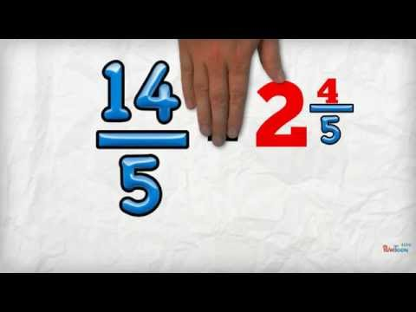
Engage - Monday
Instructions:
Watch the video to learn more about mixed numbers and improper fractions.
Click on the Edwin logo to take you to an Edwin activity that allows you to write improper fractions by dividing shapes.

Slide 15
Explore
Type answer here
Type answer here
Type answer here
Type answer here
Type answer here
Type answer here

Slide 16
Explain - Monday
What’s one thing you learned/remembered about
mixed numbers and improper fractions?
Where’s a place that you’ve seen improper fractions or mixed numbers in the world?
What’s one question you still have about improper fractions or mixed numbers?

Slide 17
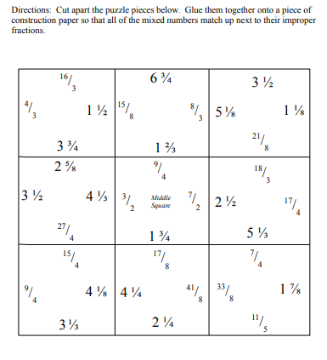
Extend - Monday
If you’ve finished early or would like more
practice, check out some of these extension
activites:
Online game:
Fraction PacMan

Slide 18
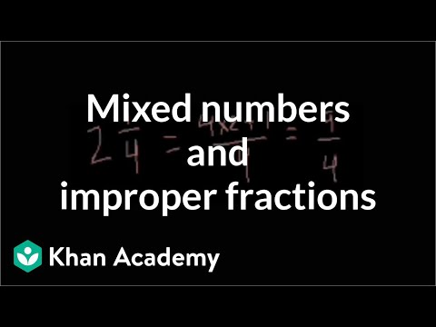
Engage - Tuesday
Instructions:
Watch the video to learn more about mixed numbers and improper fractions.
Click on the Edwin logo to take you to an Edwin activity that allows you to write improper fractions by dividing shapes.

Slide 19
Explore - Tuesday
Instructions:
Time to check-in to see how you’re doing with this week’s learning goals.
On your own paper, try to solve the word problem below.
A cookie recipe calls for 4/3 cups of flour. Mr. Williams is not sure what this means. Help him out by figuring out how much flour he needs using a mixed number. Show your work in pictures, numbers and words.

Slide 20
Explain - Tuesday
Insert Flipgrid (or whatever recording platform
you want) link here to have students share their
answers to the word problem.

Slide 21
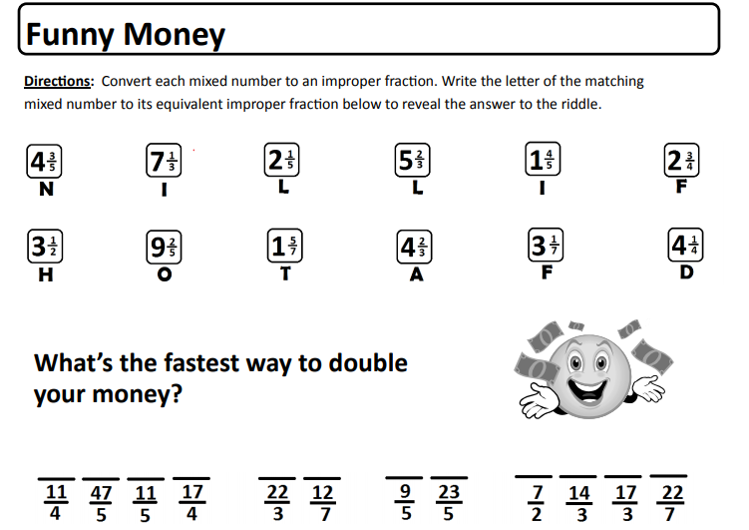
Extend - Tuesday
If you’ve finished early or would like more
practice, check out some of these extension
activites:
Online Game:
Find the Mixed number

