Slide 1
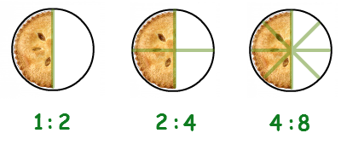
Ratios Unit
Grade 6 - SHJH - Extra Week
Learning Goals: I can …
Identify ratios that I see in real life and represent them in number form
Identify if ratios are equivalent or not
Solve a word problem involving ratios

Slide 2
Engage - Monday
Instructions:
Watch the Mashup Math video to introduce you to what an equivalent ratio is.

Slide 3
Explore - Monday
Instructions:
Click on the math textbook to take you to an online copy of the unit we’re currently working on, Fractions, Ratios & Percents
Practice:
Read through pages 180-181. Focus on understanding what an equivalent ratio is.
Use the virtual red and yellow coloured counters on this link to follow along with the “Connect” section in your textbook.
Do questions #1 (choose 5), #2 and #3 on page 182 on your own paper.

Slide 4
Explain - Monday
What’s one thing you learned about equivalent ratios?
Where’s a place that you’ve seen equivalent ratios used around your home?
What’s one question you still have about equivalent ratios?

Slide 5
Extend - Monday
If you’ve finished early or would like more
practice, check out some of these extension
activites:

Slide 6
Engage - Tuesday
Instructions:
Click on the Edwin logo to take you to an Edwin video that will teach you more about equivalent ratios.
Instructions:
Click on the Edwin logo to take you to an interactive tool that will teach you more about finding equivalent ratios.

Slide 7
Explore
Type
here
Type
here
Type
here
Type
here
Type
here
Type
here
Type
here
Type
here
Type
here
Type
here
Type
here
Type
here

Slide 8
Type
here
Type
here
Type
here
Type
here
Type
here
Type
here
Type
here
Type
here
Type
here
Type
here
Type
here
Type
here
Type
here
Type
here
Type
here
Type
here
Type
here
Type
here
Type
here
Type your answer here
Notes:
Explore Page 2 - Play the game in question #1 with someone at home or a classmate if you can. If you can’t, just move on to the next question.

Slide 9
Explain - Tuesday
What’s one thing you learned about equivalent
ratios?
Where’s a place that you’ve seen equivalent ratios used in the world?
What’s one question you still have about equivalent ratios?

Slide 10
Extend - Tuesday
If you’ve finished early or would like more
practice, check out some of these extension
activites:

Slide 11
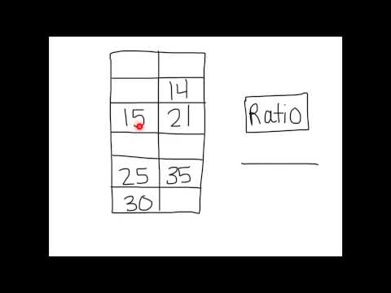
Engage - Wednesday
Instructions:
Click on the Edwin logo to take you to a video that will teach you more about using tables to find equivalent ratios.
Instructions:
Watch the video to learn more about using tables to help you find equivalent ratios.

Slide 12
Explore - Wednesday
Instructions:
Click on the math textbook to take you to an online copy of the unit we’re currently working on, Fractions, Ratios & Percents
Practice:
If needed, review pages 180-181 to refresh your memory on what we’ve learned about equivalent ratios so far.
On your own paper, do questions #5 & 6 on page 182.
Choose one of the problems to share with me. Take a picture of your work and post it on the next slide.
Remember to keep your work as neat as possible and to include a summary sentence.

Slide 13
Explore - Wednesday
Insert a picture of your work for question #5 or 6
here.
Or, if you’d rather explain your work using a
Flipgrid or video, go here.
Insert Your Own Link!

Slide 14
Explain - Wednesday
What’s one thing you learned about equivalent
ratios?
Where’s a place that you’ve seen equivalent ratios in the world?
What’s one question you still have about equivalent ratios?

Slide 15
Extend - Wednesday
If you’ve finished early or would like more
practice, check out some of these extension
activites:

Slide 16
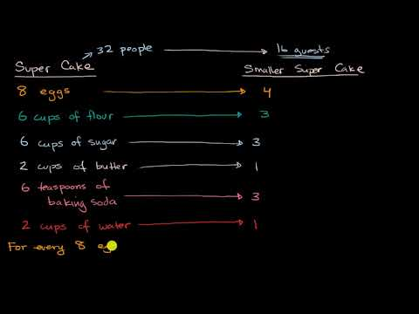
Engage - Thursday
Instructions:
Watch the video to learn more about using equivalent ratios when baking.
Instructions:
Click on the Edwin logo to take you to a video that will teach you more about using equivalent ratios when baking.

Slide 17
Explore - Thursday
Instructions:
Click on the math textbook to take you to an online copy of the unit we’re currently working on, Fractions, Ratios & Percents
Practice:
If needed, review pages 180-181 to refresh your memory on what we’ve learned about equivalent ratios so far.
On your own paper, do questions #9 & 11 on page 183.
Choose one of the problems to share with me. Take a picture of your work and post it on the next slide or create a Flipgrid video. Remember to keep your work as neat as possible and to include a summary sentence!

Slide 18
Explore - Thursday
Insert a picture of your work for question #9 or
11 here.
Or, if you’d rather explain your work using a
Flipgrid video, go here.
Insert Your Own Link!

Slide 19
Explain - Thursday
What’s one thing you learned about equivalent ratios?
Where’s a place that you’ve seen equivalent ratios in the world?
What’s one question you still have about equivalent ratios?

Slide 20
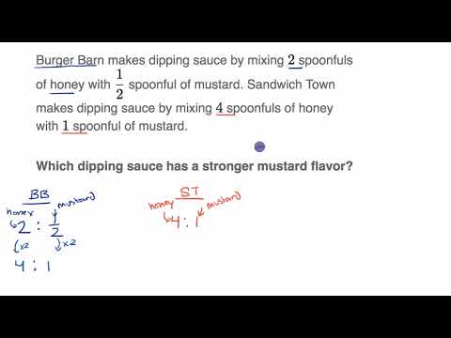
Engage - Friday
Instructions:
Watch the Khan Academy video below to learn more about finding equivalent ratios.

Slide 21
Explore - Friday
Instructions:
Time to check-in to see how you’re doing with this week’s learning goals.
Click on the link below to complete the Quizzizz activity.
Same as last Friday (Different quiz)

Slide 22
Explain - Friday
What’s one thing you learned about equivalent ratios?
Where’s a place that you’ve seen equivalent ratios in the world?
What’s one question you still have about equivalent ratios?

Slide 23
Extend - Friday
If you’ve finished early or would like more
practice, check out some of these extension
activites:

Slide 24
Percentages
Grade 6 - SHJH - Week 6
Learning Goals: I can …
explain that “percent” means “out of 100”
represent a given percent concretely and pictorially
record the percent displayed in a given concrete or pictorial representation

Slide 25
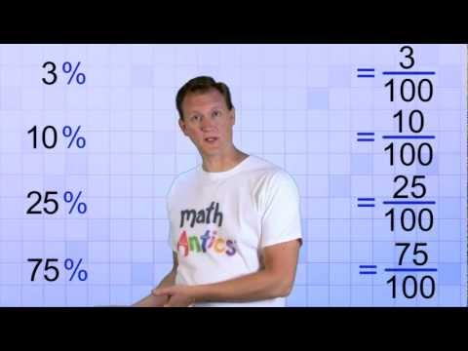
Engage - Monday
Instructions:
Watch the Math Antics video, to learn more about “percent”

Slide 26
Explore - Monday
Instructions:
Click on the math textbook to take you to an online copy of the unit we’re currently working on, Fractions, Ratios & Percents
Practice:
Read through pages 186-187. Focus on understanding what a percent is, and what it consists of.
Use this link to access Base-10 blocks, to complete the Explore. (Allow Flash, then find “Base-10” under the Manipulatives option.)
Do questions #1, #2 and # 4 on page 188 on your own paper. Upload a clear picture of your work, on the next slide.

Slide 27
Upload a picture of your work, onto this slide

Slide 28
Explain - Monday
What’s one thing you learned about percentages?
Where’s a place that you’ve seen percentages used around your home?
What’s one question you still have about percentages?

Slide 29
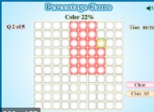
Extend - Monday
If you’ve finished early or would like more
practice, check out some of these extension
activites:

Slide 30
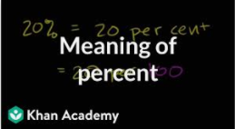
Engage - Tuesday
Instructions:
Click on the picture to the left, which will teach you more about percentages.
Instructions:
Click on the Edwin logo to take you to an interactive tool that will teach you more about percentages.

Slide 31
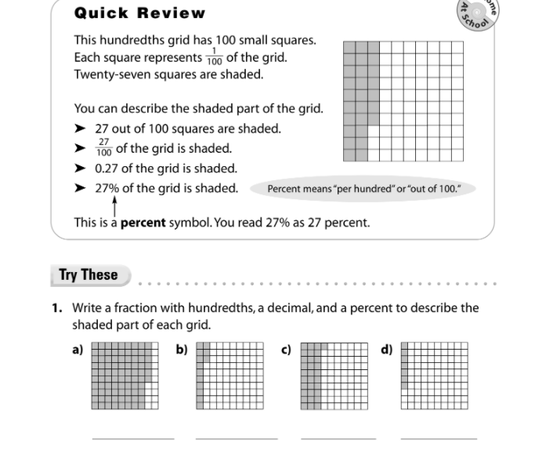
Explore
On Paper

Slide 32
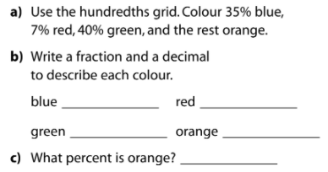
For A, use the hundredths grid to colour squares based on the percentages below. To colour a square, use the “Fill Colour” tool and select the appropriate colour.
Answer B & C on the same paper from the previous questions, and attach to the next slide.
Explore

Slide 33
Explore
Upload a picture of your work, on this slide

Slide 34
Explain - Tuesday
What’s one thing you learned about percentages?
Where’s a place that you’ve seen percentages used in the world?
What’s one question you still have about percentages?

Slide 35
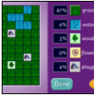
Extend - Tuesday
If you’ve finished early or would like more
practice, check out this extension
activity:

Slide 36
Engage - Wednesday
Instructions:
Watch the video to learn more about converting decimals to percents.

Slide 37
Explore - Wednesday
Instructions:
Click on the math textbook to take you to an online copy of the unit we’re currently working on, Fractions, Ratios & Percents
Practice:
If needed, review pages 186-187. to refresh your memory on what we’ve learned about percentages so far.
On your own paper, do questions #8, 9, 10, 11 and Reflect on page 189.
Take a picture of your work and upload it to the next slide.

Slide 38
Explore - Wednesday
Insert a picture of your work here:

Slide 39
Explain - Wednesday
What’s one thing you learned about percentages?
Where’s a place that you’ve seen percentages in school?
What’s one question you still have about percentages?

Slide 40
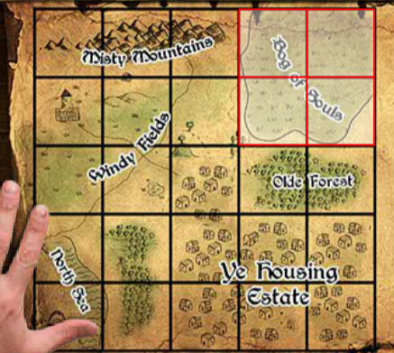
Extend - Wednesday
If you’ve finished early or would like more
practice, check out some of these extension
activites:

Slide 41
Engage - Thursday
Instructions:
Watch the video to learn about relating Fractions/Decimals/Percents
Instructions:
Click on the Edwin logo to take you to a video that will teach you more about relating fractions and decimals to percents.

Slide 42
Explore - Thursday
Instructions:
Click on the math textbook to take you to an online copy of the unit we’re currently working on, Fractions, decimals & Percents
Practice:
Read pages 191-192 to learn more about relating Fractions, Decimals and Percents
On the next slide, you will work on parts of questions 1,2,3 from page 192
If you have graph paper, and would prefer to do this activity on paper, you may. Just take a picture and upload your work to the appropriate slide.

Slide 43
Question 1- Pg. 192
*** Pick 3 out of (A-H) and answer on this slide***
Use the Hundredths grid to shade each fraction (like you did on Tuesday). You will need to re-use the grid for each question). Then, in the text box below, write each Fraction as a Decimal and a Percent (right on this slide)
Decimal = Percent =
Decimal = Percent: =
Decimal = Percent =

Slide 44
Question 2- Pg. 192
*** Pick 3 out of (A-H) and answer on this slide***
Use the Hundredths grid to shade each decimal (you will need to re-use the grid for each question). Then, in the box below, write each Decimal as a Fraction and a Percent.
Fraction = Percent =
Fraction = Percent: =
Fraction = Percent =

Slide 45
Question 3- Pg. 192
*** Pick 3 out of (A-H) and answer on this slide***
Use the Hundredths grid to shade each Percent. (you will need to re-use the grid for each question). Then, in the box below, write each Percent as a Fraction and a Decimal.
Decimal = Fraction =
Decimal = Fraction: =
Decimal = Fraction =

Slide 46
Explore - Thursday
Insert a picture of your work here (If you chose to
do your work on graph paper):

Slide 47
Explain - Thursday
What’s one thing you learned about the relationship
between fractions, decimals and percentages?
Give an example of when you might need to convert a fraction or decimal to a percent?
What’s one question you still have about decimals, fractions or percents?

Slide 48
Extend - Thursday
If you’ve finished early or would like more
practice, check out some of these extension
activites:

Slide 49
Engage - Friday
Instructions:
Watch the Khan Academy video below to learn more about relating fractions, decimals and percents
Click the Edwin link to explore more about relating fractions, decimals and percents.

Slide 50
Explore - Friday
Instructions:
Click on the math textbook to take you to an online copy of the unit we’re currently working on, Fractions, Decimals & Percents
Practice:
Review pages 191-192 to learn more about relating Fractions, Decimals and Percents.
Do questions 4, 6, 8, 10, 11 from pages 192-193 on paper, and upload a picture of your work on the next slide.

Slide 51
Explore - Friday
Insert a picture of your work here:

Slide 52
Explain - Friday
What’s one thing you learned about relating fractions,
decimals, and percents?
Where’s a place that you’ve seen percentages in the world?
What’s one question you still have about relating fractions, decimals and percents?

Slide 53
Extend - Friday
If you’ve finished early or would like more
practice, check out some of these extension
activites:

