Slide 1
Monday
Tuesday
Wednesday
Thursday
Friday
Area Unit
Math Week 8:
Challenge
Extras
Explain and use models to determine the area of any polygon.
Generalize a formula to determine the area of a polygon.
Links

Slide 2
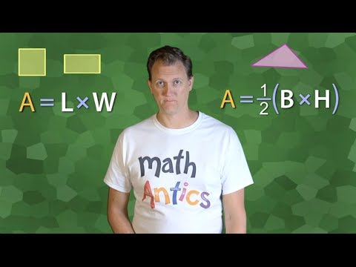
Monday
Monday
Tuesday
Wednesday
Thursday
Friday
To Do List
Monday
What is Area?
The amount of surface or the size of a surface. The space inside a perimeter.
Formula for a rectangle: A = L x W
Formula for a triangle: A = ½ B x H
Watch the video
Calculate the area and perimeter of the 2 shapes on the next slide.
Record how you solved one of them on Flipgrid.
Challenge
Extras
Links

Slide 3
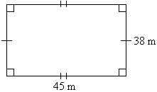
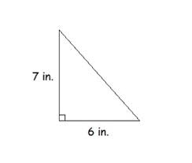
Monday
What is the area and perimeter?
Explain how you solved this question by clicking on:
What is the area and perimeter?
9 in.

Slide 4
Tuesday
Monday
Tuesday
Wednesday
Thursday
Friday
To Do List
Tuesday
Watch the video
Calculate the area and perimeter of the 2 shapes on the next slide.
Record how you solved one of them on Flipgrid.
Challenge
Extras
Links

Slide 5
Tuesday
What is the Area and Perimeter?
What is the Area and Perimeter?
Explain how you solved this question by clicking on:
67 cm
23 m
32 cm
84 m
56 cm

Slide 6
Wednesday
Monday
Tuesday
Wednesday
Thursday
Friday
To Do List
Wednesday
Click on the Math Makes Sense Text
Read pages 232 and 233
Do questions 1,2 and 3 on page 233 on the next slide.
Challenge
Extras
Links

Slide 7
Page 233 questions 1,2 and 3
Wednesday
1a)
1b)
1c)
1d)
Estimate
2a)
2b)
2c)
Actual Area
2a)
2b)
2c)
Order -
3)
Rectangle | Length | Width | Area
A | 7 | 5
B |  | 6 | 12.6
C | 3 |  | 13.5
D | 5.3 | 7

Slide 8
Thursday
Monday
Tuesday
Wednesday
Thursday
Friday
To Do List
Thursday
Click on Math Makes Sense Text
Go to page 233 and do questions 4 and 5 on paper.
Copy and paste a picture of your work on the next slide
Watch the videos if you need help.
Challenge
Extras
Question 4
Question 5
Links

Slide 9
Page 233, Questions 4 & 5
Thursday
Paste a picture of your work for
question 4 here:
Paste a picture of your work for
question 5 here:

Slide 10
Friday
Monday
Tuesday
Wednesday
Thursday
Friday
To Do List
Friday
Click on the picture on the left for today’s activity
Watch the video and play the dunk tank game.
Challenge
Dunk Tank Area Game
Extras
Links

Slide 11
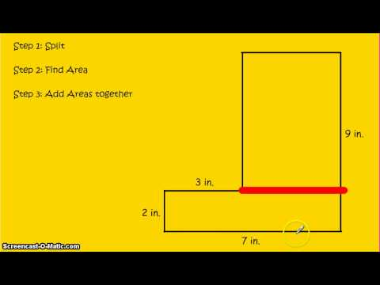
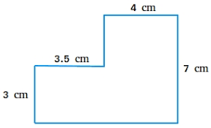
Monday
Tuesday
Wednesday
Thursday
Friday
To Do List
Try This Challenge
Figure out this shapes area.
Possible answers:
Check out this video:
Drag the correct answer here:
Explain how you solved it:
Challenge
Extras
7.5 cm
Links
25 ㎠
38.5 ㎠
52.5 ㎠

Slide 12
Extras
Extras
Monday
Tuesday
Wednesday
Thursday
Friday
To Do List
To Do List
Extras
Extras
Describe today’s instructions
Knowledgehook - Area
Prodigy
Math Makes Sense page 233 questions 6 to 9
Challenge
If you want some extra practice then try the to do list of suggestions
Extras
Links

Slide 13
Links
Monday
Tuesday
Wednesday
Thursday
Friday
Click these links go to practice sites
Links
IXL (rectangles)
IXL (triangles
Mathplayground
BrainPOP
Shape Game
Challenge
Extras
Links
Template Created by Pam Hyer

