Slide 1
Language Arts
April 27 - May 8
1
1
2
2
1
1
2
2
MONDAY
TUESDAY
Focus Topic: Electricity
1
1
2
2
1
1
2
2
1
1
2
2
WEDNESDAY
THURSDAY
FRIDAY

Slide 2
Check out these video instructions:

Slide 3
Learning Goals
Reading and Writing
I can ...
share meaningful, personal connections to deepen my understanding orally and/or in writing.
ask critical-thinking questions to clarify understanding.
explain the messages(s) of the author, with evidence
support and justify my opinions with specific evidence from the text
support and justify my opinions with personal thoughts and feelings
use writing and other representations to explore, clarify, and reflect upon my thoughts and experiences.
Science
I can ...
show how electricity in circuits can produce light, heat, sound motion.
compare a variety of electrical pathways by constructing simple circuits, series circuits, and parallel circuits
perform activities that compare the conductivity of different solids

Slide 4
1
LESSON 1 - Reading Activity
MONDAY
Read the article: “What is Static Electricity?” Click Here
April 27th

Slide 5
1
LESSON 2 | Writing Activity
MONDAY
Show what you learned in the “What is Static Electricity?” article by completing this Google Form: Click Here
Want to learn more? Click Here
April 27th.

Slide 6
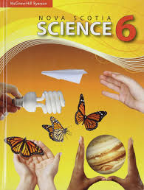
1
LESSON 1 | Reading Activity
TUESDAY
Read pages 6, 7, 10, 11 & 12 of the science text book.
Click on the textbook for the link:
April 28th

Slide 7
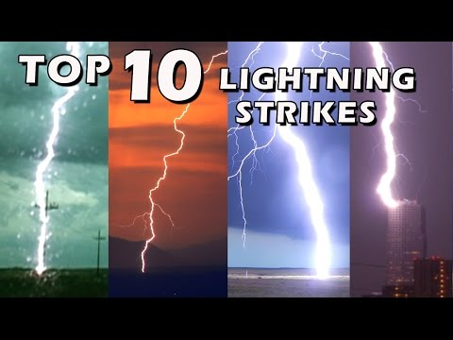
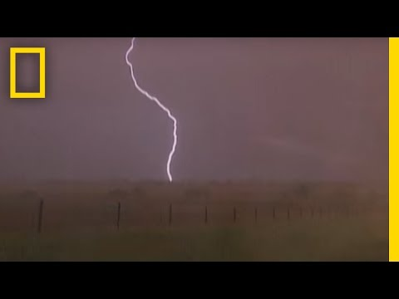
1
LESSON 2 | Writing Activity
TUESDAY
Watch these videos:
Show what you learned in today’s reading assignment
and videos about lightning by completing this
Google Form: Click Here
April 28th

Slide 8
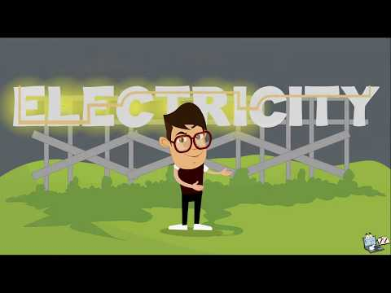
1
LESSON 1 | Reading Activity
WEDNESDAY
Read pages 15 and 22 of the science text book.
Click on the textbook for the link:
April 29th

Slide 9
1
LESSON 2 | Writing Activity
WEDNESDAY
Use the information you just learned about static electricity and current electricity, to fill in the Venn Diagram on the next slide.
In the middle write two things that static and current electricity have in common.
On the left write two things that makes current electricity different than static electricity.
On the right side write two things that make static electricity different from current electricity.
April 29th

Slide 10
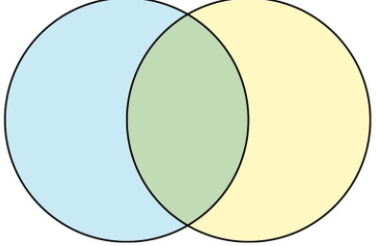
Static vs. Current Electricity
Current
Electricity
Common
Static
Electricity

Slide 11
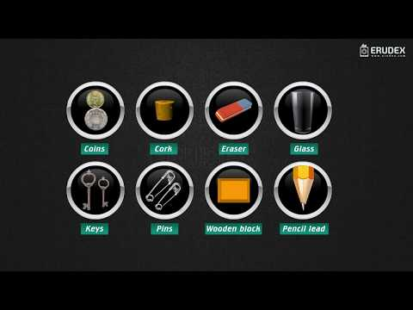
1
LESSON 1 | Reading Activity
THURSDAY
Read pages 18 and 19 of the science text book.
Click on the textbook for the link:
April 30th

Slide 12
1
LESSON 2 | Writing Activity
THURSDAY
Okay 6-2 scientists, today you’re going to do an experiment! Record your results on the table found on the next slide. Click here to take you to the experiment. Before you start, label the left column “Materials” then list the nine materials you’ll be testing (found in the experiment) in that column. Now label the right column “Conductor/Insulator”. One at a time drag each item in the experiment down and place it between the two wires so it touches both at the same time. If the bulb lights up then it’s a conductor. If it does not light up then it’s an insulator. Fill in the right side of the table based on what results you find.
April 30th

Slide 13
Thursday - Conductors and Insulators

Slide 14
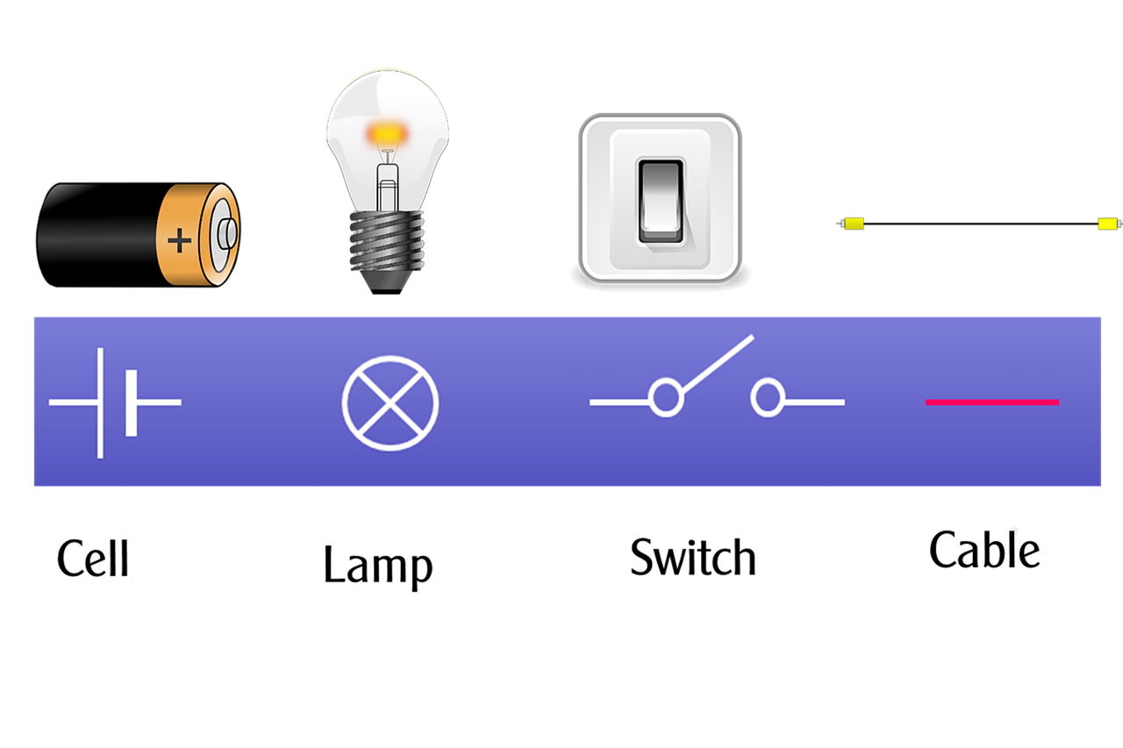
1
LESSON 1 | Reading Activity
FRIDAY
Read pages 22, 23, 24, 25, 28, 29, 31 and 32. Click on the
textbook for the link:
May 1st

Slide 15
1
LESSON 2 | Writing Activity
FRIDAY
Answer questions #1, 2 and 5 from page 32 of the textbook. Write your answers on the next slide.
If you’ve finished your questions and have time, try this extension activity:
Try to build a parallel circuit. In the video it said to build one with a motor and a bulb; for this experiment try hooking up two light bulbs in a parallel circuit. Include wires, switch and battery. Click Here to build the circuit!
May 1st

Slide 16
Friday - Page #32 Answers:
#1 -
#2 -
#5 -

Slide 17
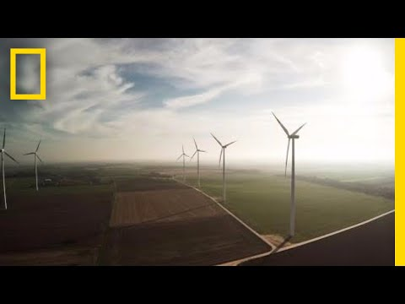
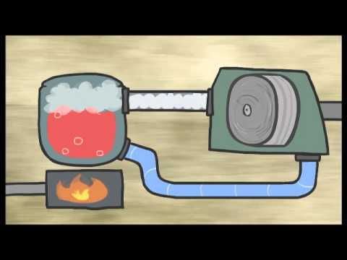
2
LESSON 1 - Reading Activity
MONDAY
Read the Article: “Types of Renewable Energy” Click Here
May 4th

Slide 18
2
LESSON 2 | Writing Activity
MONDAY
Complete the following activity. Read these instructions carefully!
First open up this document, then make a copy
Title it - Name: Sources Of Energy (ex. Lauren - Sources of Energy)
Complete the questions
When done click on share
Then click on shareable link
Finally, copy link and paste it on the next slide
May 4th

Slide 19
Monday - Sources of Energy Slide
Insert your link to “Renewable and Nonrenewable Resources” here:

Slide 20
2
LESSON 1 | Reading Activity
TUESDAY
Read the article: “Renewable Sources of Energy” Click here
Show what you learned in the article by completing this Google Form “Sources Of Electricity”: Click Here
May 5th

Slide 21
2
LESSON 2 | Writing Activity
TUESDAY
Today, and for the next few days, you are going to work on one of the activities below. You choose!
My Maps Activity:
For activity instructions Click Here.
check out this example
If you need a refresher on how to use My Maps watch this video: click here
OR
WeVideo Activity:
Create a We Video that teaches others about solar, hydro, geothermal, wind, biomass and tidal power. Go to tools in Edwin to open WeVideo
May 5th

Slide 22
2
LESSON 1 | Reading Activity
WEDNESDAY
Read the Edwin article: “Using the Electromagnetic Connection to Generate Electricity”. Click Here
***Don’t do questions.***
May 6th

Slide 23
2
LESSON 2 | Writing Activity
WEDNESDAY
Continue working on the My Maps activity or the WeVideo activity, whichever one you chose. Remember to follow the instructions carefully!
May 6th

Slide 24
2
LESSON 1 | Reading Activity
THURSDAY
Read The Newsela article:
“Types of Renewable Energy” Click Here
May 7th

Slide 25
2
LESSON 2 | Writing Activity
THURSDAY
Today complete the My Maps activity or the WeVideo activity. Remember to edit carefully for spelling and capitals!
If you did the My Maps activity share it with me.
If you did the Wevideo save it to your drive and then
share it with me.
May 7th

Slide 26
2
LESSON 1 | Reading Activity
FRIDAY
Read the Edwin article:
“Solar Absorbers and the Future of Electricity.” Click Here
May 8th

Slide 27
2
LESSON 2 | Writing Activity
FRIDAY
On the next slide I would like you to write a detailed paragraph response to one of the following prompts:
Summarize what you already knew or learned about electrical circuits.
OR
2) Summarize what you already knew or learned about renewable and non renewable energy.
*** Remember to edit your work carefully! ***
May 8th

Slide 28
Friday - Summary Paragraph:

