Slide 1
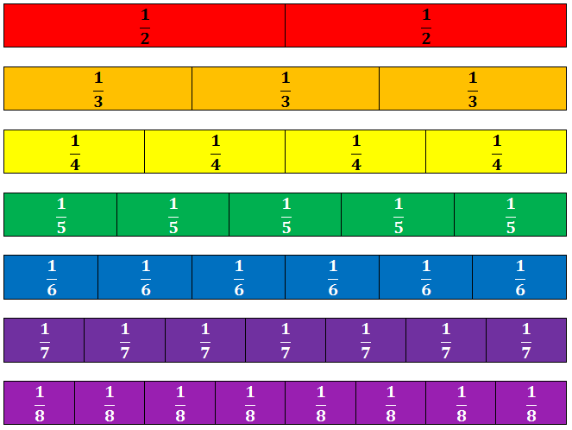
Fractions Unit
Grade 6 - SHJH - Week 2
Learning Goals: I can …
Represent a mixed number using picture and symbolic form
Represent an improper fraction using picture and symbolic form
Place fractions (including improper and mixed number) on a number line and explain how I figured out where to put them

Slide 2
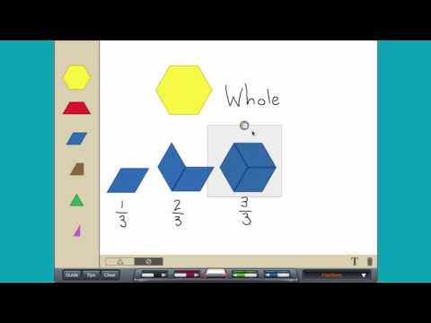
Engage - Monday
Instructions:
Click on the Edwin logo to take you to an Edwin video that will teach you more about mixed numbers and improper fractions.
You can add this extension to your Edwins to have access to virtual pattern blocks. They’ll help you with the “Explore” activity sheet.
Pattern Shapes by the Math Learning Center
.

Slide 3
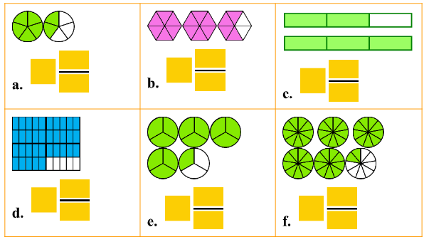
Explore - Monday
Instructions:
Can you figure out what mixed number is being represented by the pictures? Fill in your answers in the text boxes.

Slide 4
Explore
Do these questions on your own paper. Use virtual pattern blocks to help when needed.

Slide 5
Explain - Monday
What’s one thing you learned/remembered about
mixed numbers or improper fractions?
Where’s a place that you’ve seen mixed numbers or improper fractions used around your home?
What’s one question you still have about mixed numbers or improper fractions?

Slide 6
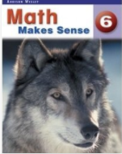
Extend - Monday
If you’ve finished early or would like more
practice, check out some of these extension
activites:
‘’
Click on the textbook link and review page 167. Work through some of questions #1-5 on page 168.

Slide 7
Extend
Type answer here
Type answer here
Type answer here

Slide 8
Engage - Tuesday
Instructions:
Watch the video to learn more about drawing mixed numbers and improper fractions.
Click on the Edwin logo to take you to an Edwin video that will teach you more about mixed numbers and improper fractions.

Slide 9
Explore
Do these questions on
your own paper.
Choose some from
each question.

Slide 10
Explain - Tuesday
Instructions:
Answer the question above either on your own paper or on your Edwin’s Chrome Canvas. Email a quick video to me (create a screencast if you’re using Canvas) showing me what you think the answer is and why.
Or, you can explain your work to me using this Flipgrid link (add link!)

Slide 11
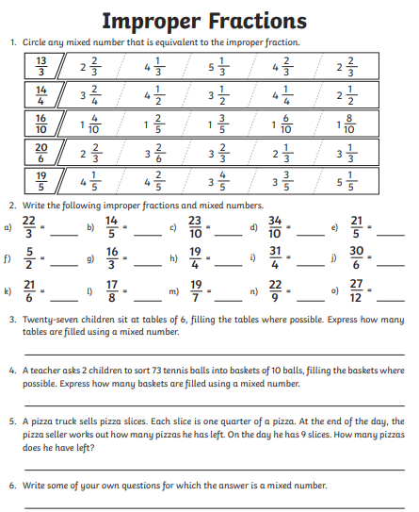
Extend - Tuesday
If you’ve finished early or would like more
practice, check out some of these extension
activites:

Slide 12
Extend

Slide 13
Engage - Wednesday
Instructions:
Watch the video to learn more about mixed numbers and improper fractions.
Click on the Edwin logo to take you to a video that shows you more about comparing improper fractions and mixed numbers.

Slide 14
Explore - Wednesday
Instructions:
Try to solve the word problem below on your own paper. When you think you’ve found the right answer, take a picture of your work and insert this picture on the next slide. Remember to include a picture and summary sentence.
Four friends were at a party. Prince said he ate 5/3 of pizza while David stated he ate 5/4 of pizza. Mackenzie said that David ate more pizza than Prince. Is Mackenzie correct? Explain your thinking with pictures, numbers and words.

Slide 15
Explain - Wednesday
Instructions:
Post a picture of how you attempted to solve the word problem here

Slide 16
Explain - Wednesday
What’s one question you still have about comparing
improper fractions and mixed numbers?

Slide 17
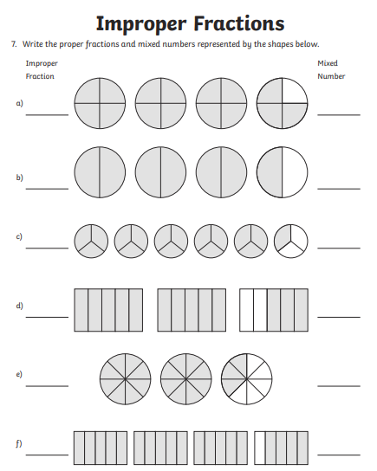
Extend - Wednesday
If you’ve finished early or would like more
practice, check out some of these extension
activites:

Slide 18
Extend

Slide 19
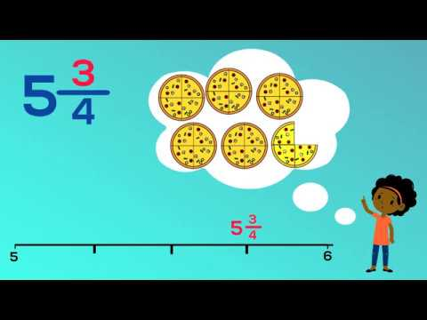
Engage - Thursday
Instructions:
Watch the video to learn more about placing mixed numbers on a number line.
Click on the Edwin logo to take you to an activity that allows you to practice placing improper fractions on a numberline.

Slide 20
Explore - Thursday
Instructions:
Click on the math textbook to take you to an online copy of the unit we’re currently working on, Fractions, Ratios & Percents
Practice:
Review the “Connect” section on pages 172-173 to help you to understand how to compare mixed numbers and improper fractions using a number line.
On your own graph paper, do questions 1-2 on pgs 173. Be sure to count the lines between the numbers carefully so that your number lines are accurate, they need to look the same as the ones in the textbook.
* ** If you don’t have graph paper at home, take a screenshot of the number lines that you need from the textbook and post them to Canvas to answer the questions. If you aren’t sure how to take a screenshot click here.

Slide 21
Explain - Monday
What’s one thing you learned/remembered about
comparing mixed numbers and improper fractions?
Give an example of when you think it would be a good idea to show an improper fraction as a mixed number in the real world?
What’s one question you still have about putting improper fractions or mixed numbers on a number line?

Slide 22
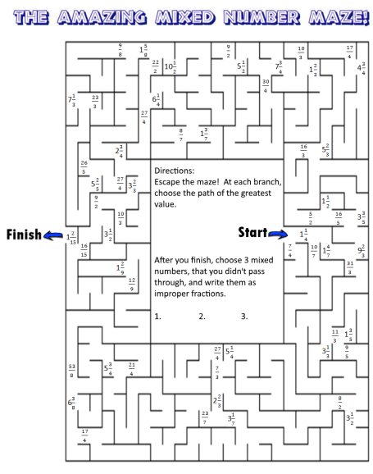
Extend - Monday
If you’ve finished early or would like more
practice, check out some of these extension
activites:

Slide 23
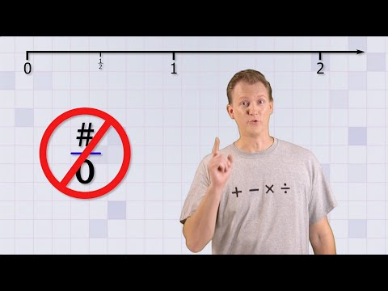
Engage - Tuesday
Instructions:
Watch the Math Antics video to learn more about comparing fractions by using a number line.
Click on the Edwin logo to take you to an activity that allows you to practice comparing fractions using number lines.

Slide 24
Explore - Tuesday
Instructions:
Time to check-in to see how you’re doing with this week’s learning goals.
On your own paper, try to solve the problem below.
Draw a number line from 1 to 5 and place the following improper fractions and mixed numbers on it.
1 1/2 , 6/4 , 2¾ , 9/4, 3/3

Slide 25
Explain - Tuesday
Insert Flipgrid (or whatever recording platform
you want) link here to have students share their
answers to the word problem.

Slide 26
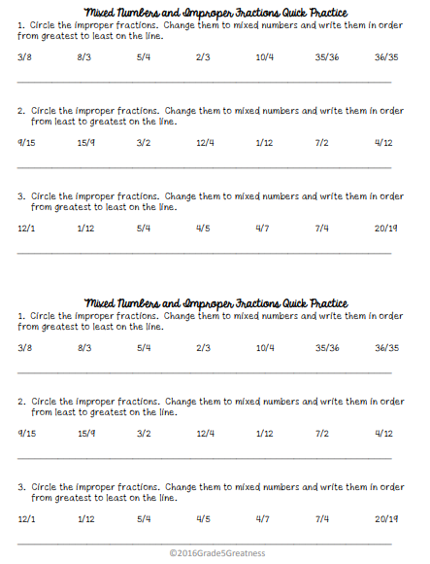
Extend - Tuesday
If you’ve finished early or would like more
practice, check out this extension
activity:

