Slide 1
Monday
Tuesday
Wednesday
Thursday
Friday
Perimeter Unit
Math Week 7: May
Challenge
Extras
Explain and use models to determine the perimeter of any polygon.
Generalize a formula to determine the Perimeter of a polygon.
Links

Slide 2
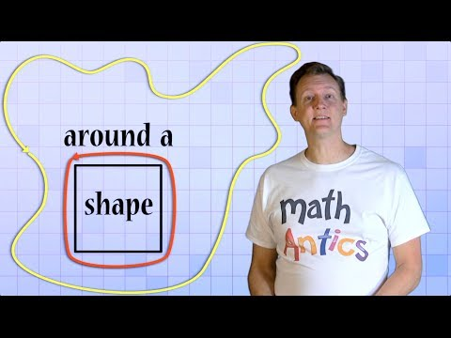
Monday
Monday
Tuesday
Wednesday
Thursday
Friday
To Do List
Monday
What is Perimeter?
The distance around a closed shape or the length of its boundaries. The perimeter of a circle is called the “ circumference”.
Formula: P = S1 + S2 + S3 + S4
Watch the video
Calculate the perimeter of the 2 shapes on the next slide.
Record how you solved one of them on Flipgrid.
Challenge
Extras
Links

Slide 3
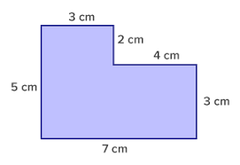
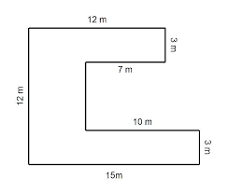
Monday
What is the perimeter?
Explain how you solved this question by clicking on:
What is the perimeter?

Slide 4
Tuesday
Monday
Tuesday
Wednesday
Thursday
Friday
To Do List
Tuesday
Watch the video
Calculate the perimeter of the 2 shapes on the next slide.
Record how you solved one of them on Flipgrid.
Challenge
Extras
Links

Slide 5
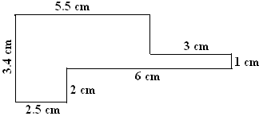
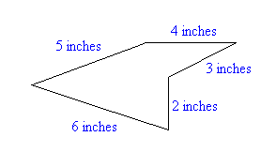
Tuesday
What is the Perimeter?
What is the Perimeter?
Explain how you solved this question by clicking on:

Slide 6
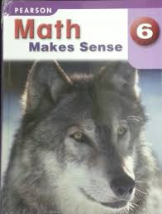
Wednesday
Monday
Tuesday
Wednesday
Thursday
Friday
To Do List
Wednesday
Click on the Math Makes Sense Text
Read pages 227 and 228
Do questions 1,3 and 5 on page 229 on the next slide.
Challenge
Extras
Links

Slide 7
Page 229 questions 1, 3, 5
Wednesday
1a)
1b)
1c)
1d)
1a)
1b)
5)

Slide 8
Thursday
Monday
Tuesday
Wednesday
Thursday
Friday
To Do List
Thursday
Watch the video explaining formulas
Click on Math Makes Sense Text
Go to page 230 and do questions 6 and 7 on the next page.
Challenge
Extras
Links

Slide 9
Page 230, Questions 6 & 7
Thursday
6a)
6b)
6c)
7a)
7b)

Slide 10
Friday
Monday
Tuesday
Wednesday
Thursday
Friday
To Do List
Friday
What is the length and Width of my back yard?
Watch the video of today’s question
Calculate what are the possible measurements of the length and width of my backyard.
You may want to sketch out the possibilities on a piece of paper.
Write your answers on the next slide.
Challenge
Extras
Links

Slide 11
Backyard Perimeter Question
Friday
Possible answers:
Length = Width=
Length = Width=
Length = Width=
Length = Width=
This is my best calculation of the length and width of your backyard:
Length = Width=

Slide 12
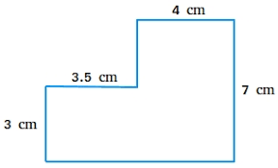
Monday
Tuesday
Wednesday
Thursday
Friday
To Do List
Try This Challenge
Figure out the length of the missing side and then figure out this shapes perimeter.
Possible answers:
Drag the correct answer here:
Explain how you solved it:
Challenge
Extras
Links
17.5 cm
28 cm
25 cm

Slide 13
Extras
Extras
Monday
Tuesday
Wednesday
Thursday
Friday
To Do List
To Do List
Extras
Extras
Describe today’s instructions
Knowledgehook - Perimeter
Prodigy
Math Makes Sense page 230 questions 9 and Reflect
Challenge
If you want some extra practice then try the to do list of suggestions
Extras
Links

Slide 14
Links
Monday
Tuesday
Wednesday
Thursday
Friday
Click these links go to practice sites
Links
IXL
Shape Surveyor
Shape Game
Climber
Perimeter Snatch
Challenge
Extras
Links
Template Created by Pam Hyer

