Slide 1
Language
Arts
Weeks 5&6
May 11 to May 22
Theme: Poetry

Slide 2
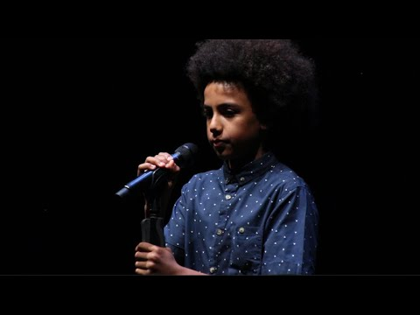
How this works:
For the next 2 weeks you will be completing reading and writing activities that focus on poetry.
You do not need to make a copy of the slides because I shared with each of you your own copy. Do all of your work on the slides provided.
What is poetry? Poetry is a type of literature, or artistic writing, that attempts to stir a reader's imagination or emotions. The poet does this by carefully choosing and arranging language for its meaning, sound, and rhythm.
Check out this Slam Poetry:

Slide 3
I can...
share meaningful, personal connections to deepen my understanding orally and/or in writing.
explain the messages(s) of the author, with evidence
support and justify my opinions with personal thoughts and feelings
use writing and other representations to explore, clarify, and reflect upon my thoughts and experiences.
Use descriptive words expressively to share thoughts and opinions in poetic forms.

Slide 4
I can...
use digital tools to plan, create, and publish their work both individually and collaboratively.
problem solving skills using digital tools both individually and collaboratively
create and/or present expressive artworks in the arts for a range of audiences and purposes.

Slide 5
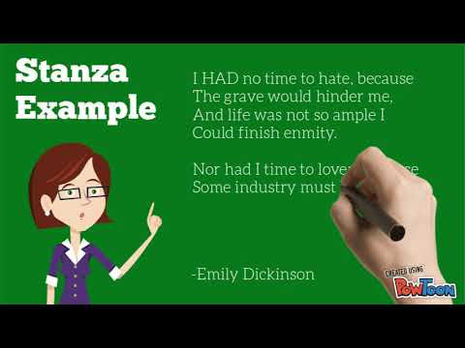
Reading Activity
1
MONDAY
Instructions:
Read the article, “An Artist Comes to Canada” and answer the 1st question on the next slide.
May 11th

Slide 6
1
MONDAY
An Artist Comes to Canada
Question 1:
May 11th

Slide 7
Instructions:
Write a Diamante Poem
Read the example on slide 23. Now read slide 24 to understand the rules.
Write your poem on the right side.
1
Diamante Poem:
MONDAY
May 11th
Writing
Activity

Slide 8
1
TUESDAY
Instructions:
Read the poem “Spring” and answer the comprehension questions. The poem is located in the Google Reading Classroom.
May 12th
Reading Activity

Slide 9
1
TUESDAY
Magnetic poetry activity. Click here to open then follow the instructions.
When you are done take a screenshot and paste on the next slide.
May12th
Writing
Activity

Slide 10
Magnetic Poetry Screenshot
1
TUESDAY
May 12th

Slide 11
Reading Activity
1
WEDNESDAY
Instructions:
Read the example of a
“I am From Poem”
Click here
I am from examples
May13th

Slide 12
Writing
Activity
1
WEDNESDAY
Instructions:
Make a copy and complete the “I am from graphic organizer”:
Click Here
Tomorrow you will use the graphic organizer to write a final draft.
May 13th

Slide 13
Reading Activity
1
THURSDAY
Instructions:
Read the poem “My secret Place.” The article is in the Google Reading Classroom.
Or Click Here.
Then answer the questions at the end of the poem on the next slide.
May 14th

Slide 14
1
THURSDAY
My Secret Place Answers:
May14th

Slide 15
Writing
Activity
1
THURSDAY
Instructions:
Today you will write a “I AM FROM” poem. Use what you wrote in the graphic organizer yesterday. Each color will represent a stanza. So start with, I am from (now write the things you put in the 3 purple sections. Skip a line then write, I am from (now write the things you put in the 3 yellowish section. Continue these steps for each colored section.
Write final draft on the next slide
May 14th

Slide 16
I Am From...
1
Continue here
THURSDAY
May14th
Type here

Slide 17
Reading Activity
1
Instructions:
Read the poem,
“Living By The Sea”.
It is located on the reading classroom.
Or click on the Edwin link.
As you read think about how you would answer the questions you have read.
FRIDAY
May 15th

Slide 18
Writing
Activity
1
Instructions:
Try this animal writing activity.
Click here
When you are done take a screenshot and paste it on the next slide.
FRIDAY
May 15th

Slide 19
Animal Writing: Screenshot
1
FRIDAY
May 15th

Slide 20
2
Instructions:
Search the internet or a book for a poem you like. Now record yourself reading the poem. Introduce the author and the title before you start. Click on the flipgrid link to record.
MONDAY
May 18th
Reading Activity

Slide 21
2
MONDAY
Instructions:
Write a Backwards poem
Read the example on slide 21. Now read slide 22 to understand the rules.
Write your own backwards poem on the next slide.
May 18th
Writing
Activity

Slide 22
Backwards Poem
2
MONDAY
May 18th

Slide 23
2
TUESDAY
Instructions:
Read the poem, “City Autumn” from ReadWorks and answer the comprehension questions.
The poem can be found in the reading classroom.
May 19th
Reading Activity

Slide 24
2
TUESDAY
Instructions:
Try this “If I’m in Charge of the World” activity.
Click here
When you are done take a screenshot and paste it on the next slide.
May 19th
Writing
Activity

Slide 25
If I’m in Charge of the World Screenshot
2
TUESDAY
May 19th
Insert Screenshot

Slide 26
3
WEDNESDAY
Instructions:
Read the poem, “A Dragon’s Lament”. It is located on the reading classroom. Or click on the Edwin link.
Answer the “reading like a writer” question on the next slide.
May 20th
Reading Activity

Slide 27
3
WEDNESDAY
Reading like a writer response:
May 20th

Slide 28
2
WEDNESDAY
Instructions:
Write a Cinquain poem
Read the example on slide 19. Now read slide 20 to understand the rules.
Write your poem on the next slide
May 20th
Writing
Activity

Slide 29
2
WEDNESDAY
Cinquain Poem:
May 20th

Slide 30
2
THURSDAY
Instructions:
Read the collection of poems, “We are the ones”. It is located on the reading classroom. Or click on the Edwin link.
May 21st
Reading Activity

Slide 31
2
THURSDAY
Instructions:
Go to this site and write a free verse poem about a topic you select. Remember free verse is a style of poem with no rules!
Click Here
Take a screenshot when you are done and paste it on the next slide.
May 21st
Writing
Activity

Slide 32
Free Verse Poem: Screenshot
2
THURSDAY
May 21st
Paste screenshot here

Slide 33
2
FRIDAY
Instructions:
Click on the famous poets link. Pick a poet from the list. Look up a portrait of them. Now with the clothing, materials and props around your house recreate that portrait with you as the poet. Take a picture and paste it on the next slide.
FAMOUS POETS
May 22nd
Art Activity

Slide 34
Famous Poet Portrait Photo
2
FRIDAY
May 22nd
Paste photo here:
Name of Poet:

Slide 35
2
FRIDAY
Instructions:
Try this “I Use To,poem activity.
Click here
When you are done take a screenshot and paste it on the next slide.
May 22nd
Writing
Activity

Slide 36
I Use To Poem: Screenshot
2
FRIDAY
May 22nd
Paste Screenshot here:

